Slide 1


Slide 2
Quorum Pizza Talk
Demystifying Speaking Part one

Slide 3
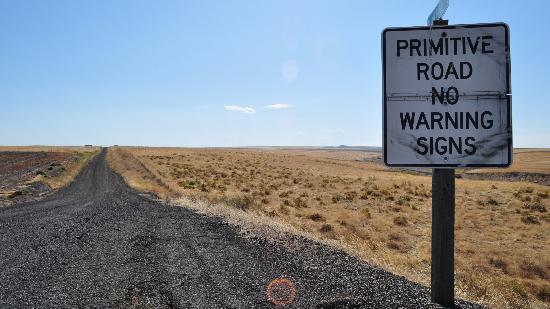
Notes:
Photo by specphotops on Unsplash
Warning this session has been thrown together

Slide 4

Notes:
Photo by Lou Batier on Unsplash
Its rough around the edges and not polished at all

Slide 5
Buyer
Beware

Slide 6

Notes:
Photo by Robert Nagy: https://www.pexels.com/photo/puzzled-gamer-in-illuminated-room-3930070/

Slide 7

Notes:
Photo by Maxime Horlaville on Unsplash

Slide 8

Notes:
Photo by Olav Ahrens Røtne on Unsplash
Challenge to the knowledgeable
Everything in this presentation has purpose
Most will be revealed not all
Will you notice it all?

Slide 9

Notes:
Photo by Tim Meyer on Unsplash
This is a buffet
Take what you want
Watch the video again and again
Ask me questions if you want

Slide 10

Notes:
Photo by Daniel Schludi on Unsplash
Let me start this session with a story

Slide 11

Notes:
Many years ago
SQL Grill had new speaker track
Never spoken at technical conferences and wanted to speak

Slide 12

Notes:
Photo by AbsolutVision on Unsplash
Thought this would be really good for a friend of my to submit to the conference
They might have a different idea!

Slide 13

Notes:
Photo by Cytonn Photography on Unsplash
Made a deal if he submitted I would submit

Slide 14

Notes:
Photo by DS stories: https://www.pexels.com/photo/word-never-combined-of-scrabble-tiles-6005514/
Confident that my sessions would not get picked

Slide 15

Notes:
So we submitted the sessions, I was confident they would never be picked

Slide 16


Notes:
William Durkin and Ben Wiessman had other ideas

Slide 17

Notes:
Photo by Miguel Á. Padriñán: https://www.pexels.com/photo/close-up-shot-of-keys-on-a-red-surface-2882686/
The selection committee said Yes !

Slide 18

Notes:
Photo by Andrey Metelev on Unsplash
So I panicked

Slide 19

Notes:
Photo by John Schnobrich on Unsplash
So I started planning my presentation

Slide 20

Notes:
Photo by cottonbro studio: https://www.pexels.com/photo/two-men-acting-on-stage-6896333/
So rehearsed,
Then rehearsed,
Then rehearsed and rehearsed

Slide 21

Notes:
Photo by Gianandrea Villa on Unsplash

Slide 22


Slide 23

Notes:
Photo by Donald Tong: https://www.pexels.com/photo/person-doing-thumbs-up-193821/
Catherine was very kind and said keep doing what you are doing

Slide 24

Notes:
Photo by Lee Myungseong on Unsplash
At the speakers dinner again I felt like an imposter, yet so many people where very kind, and some said they were looking forward to my session.

Slide 25
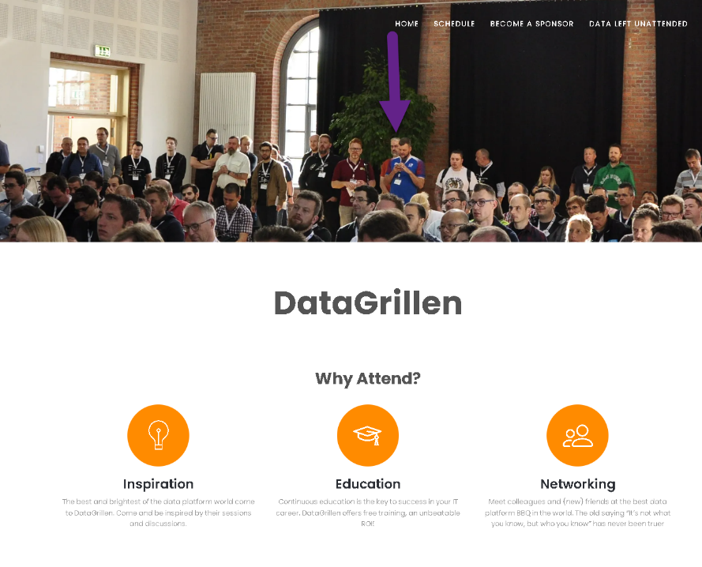

Slide 26

Notes:
Photo by Annie Spratt on Unsplash

Slide 27

Notes:
Photo by Yasser Mutwakil ياسر متوكل on Unsplash
In the speakers lounge I felt unworthy

Slide 28

Notes:
Photo by Wan San Yip on Unsplash

Slide 29

Notes:
Photo by Nik on Unsplash

Slide 30





Robert French
Chief Power BI Nerd at Quorum
Lives in Sunny Glasgow, Scotland
rwlp.french@gmail.com
@sqlbobscot
https://www.linkedin.com/in/rwlpfrench/
https://www.qnrl.com/

Slide 31

Notes:
Photo by Immo Wegmann on Unsplash
What is the goal of this session

Slide 32

Notes:
Photo by melanfolia меланфолія on Unsplash
This is just my thoughts and ideas

Slide 33

Notes:
Photo by Brett Jordan on Unsplash

Slide 34

Notes:
Photo by Marcel Eberle on Unsplash
Find at topic

Slide 35

Notes:
Photo by Emily Morter on Unsplash
So what should you take about?
For some this is an easy answer
Some not so easy
So here is some ideas

Slide 36

Notes:
Photo by Waldemar on Unsplash

Slide 37

Notes:
Photo by Kelly Sikkema on Unsplash
Creating abstract

Slide 38

Notes:
Photo by DS stories: https://www.pexels.com/photo/bronze-medal-on-white-7267601/

Slide 39

Notes:
You have been asked to create a dashboard

Slide 40

Notes:
Photo by Christian Buehner on Unsplash

Slide 41

Notes:
Photo by Natasha Connell on Unsplash
Going to talk about memory specifically short and long term memory

Slide 42

Notes:
Photo by Miguel Á. Padriñán: https://www.pexels.com/photo/gold-5-illustration-2249532/

Slide 43

Curse
of
knowledge
Notes:
https://www.journals.uchicago.edu/doi/abs/10.1086/261651
The Curse of Knowledge in Economic Settings: An Experimental Analysis
Photo by Cederic Vandenberghe on Unsplash

Slide 44

Notes:
Photo by Clem Onojeghuo on Unsplash

Slide 45

Notes:
Photo by Nick Seagrave on Unsplash
Create a mind map to get all the ideas out on somewhere

Slide 46

Notes:
Photo by Eric Prouzet on Unsplash

Slide 47

Notes:
Photo by Nick Fewings on Unsplash
Some ideas for presentations

Slide 48
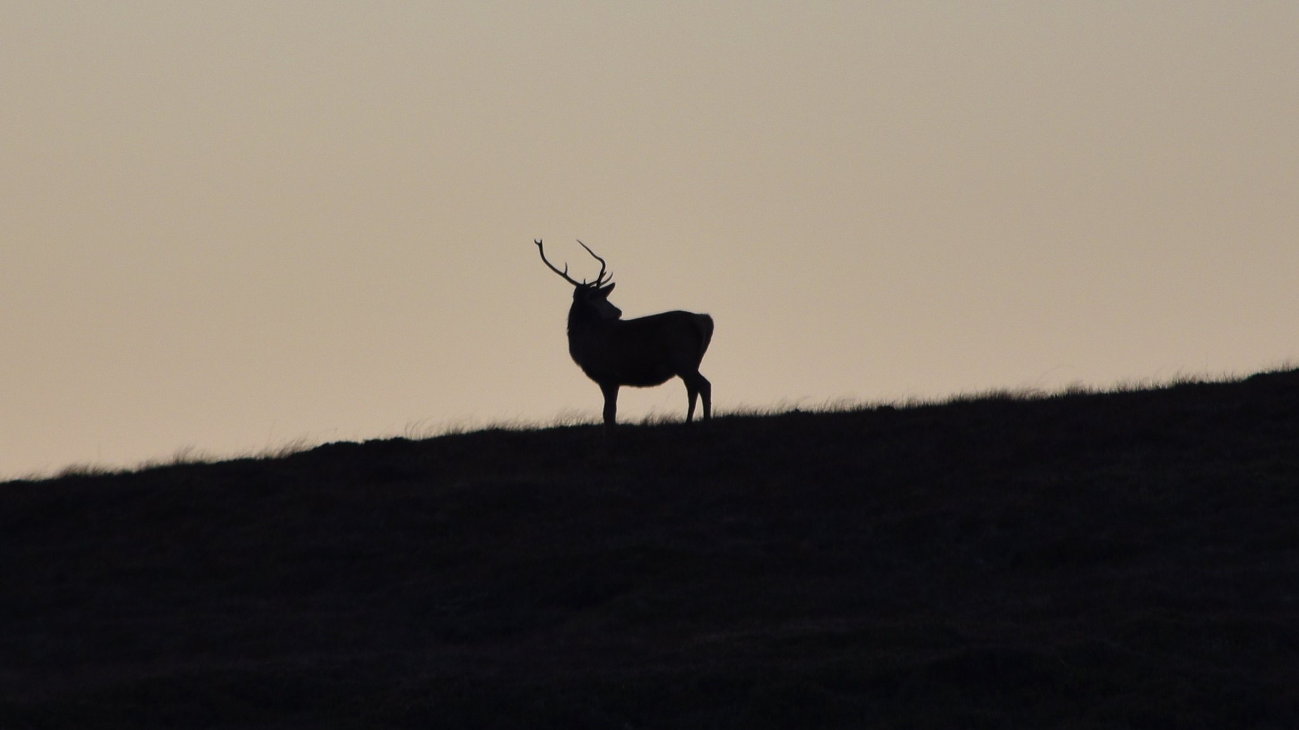

Slide 49
Notes:
Photo by Marcel Eberle on Unsplash

Slide 50
Notes:
Photo by Emily Morter on Unsplash
So what should you take about?
For some this is an easy answer
Some not so easy
So here is some ideas

Slide 51

Notes:
Photo by Kayla Farmer on Unsplash
What should talk about?

Slide 52

Notes:
Photo by Brett Jordan on Unsplash
Ask people what topics they might want to see covered
What topics they think you might be really good at talking about
Chat about what topics have not be covered in presentations

Slide 53

Notes:
Photo by Etienne Girardet on Unsplash
What are you passionate about?

Slide 54

Notes:
Photo by Adam Winger on Unsplash
Why not teach the basics
Yes again

Slide 55

Notes:
Photo by Kyle Bushnell on Unsplash
Everyone is a learner at some point
So why not cover the basics
Some of the best sessions I have been to are about the basics

Slide 56
Notes:
Photo by Waldemar on Unsplash

Slide 57
Notes:
Photo by Kelly Sikkema on Unsplash

Slide 58

Notes:
Photo by Nik on Unsplash
Why do you need an abstract?

Slide 59

Three groups
Notes:
Photo by Priscilla Du Preez 🇨🇦 on Unsplash
Three groups of people you are trying to communicate with

Slide 60

Program committee
Notes:
They decide what sessions are selected
Does you session fit ?
Is attend, a session they would like to attend or the attendees would like to attendee

Slide 61

Audience
Notes:
Photo by Matheus Bertelli: https://www.pexels.com/photo/photo-of-people-sitting-on-chairs-3321789/
Why should they come to your session?
Also the wrong people out your session!

Slide 62

Notes:
Photo by Ben Robbins on Unsplash
What are you intending to say
What’s you rmessage,
What is the session about
Its months between submitting and talking on to the audience

Slide 63

Notes:
Photo by Christy Joseph Jacob on Unsplash
What else does the abstract do?
There are more reasons than just the ones mentioned

Slide 64

Notes:
Photo by cottonbro studio: https://www.pexels.com/photo/a-woman-wearing-a-blue-jacket-10664798/
Where do you submit you sessions to?

Slide 65
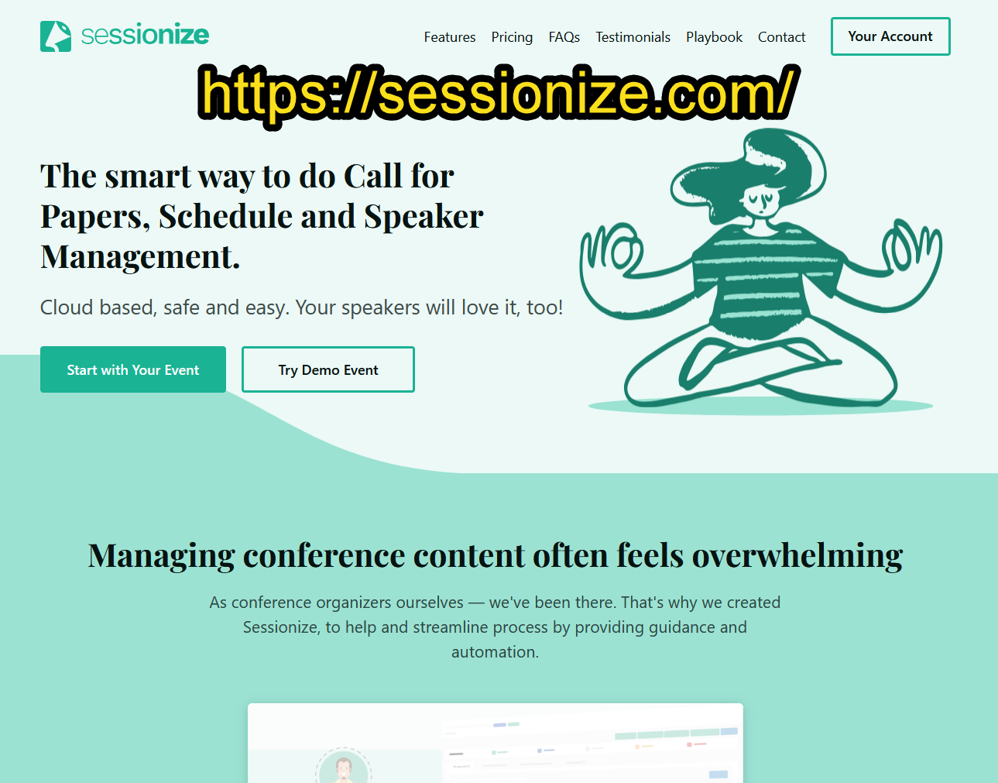

Slide 66
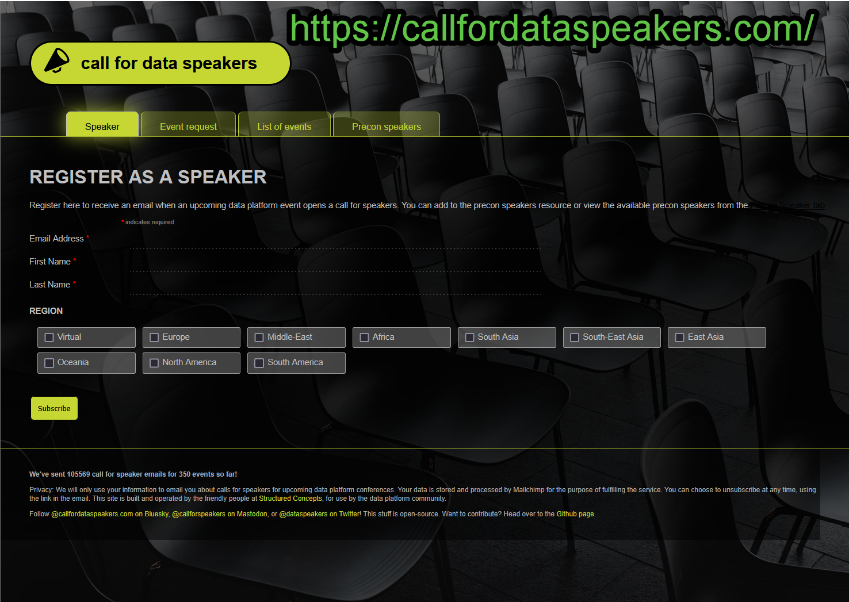

Slide 67

Notes:
Photo by Tracy Le Blanc: https://www.pexels.com/photo/person-holding-iphone-showing-social-networks-folder-607812/
Keep an eye on social media for announcements as not all conferences using Sessionise or call for speakers

Slide 68

Notes:
Photo by Lucas Vasques on Unsplash
Lets look in more detail at what you might be filling on when completing an abstract

Slide 69


Slide 70
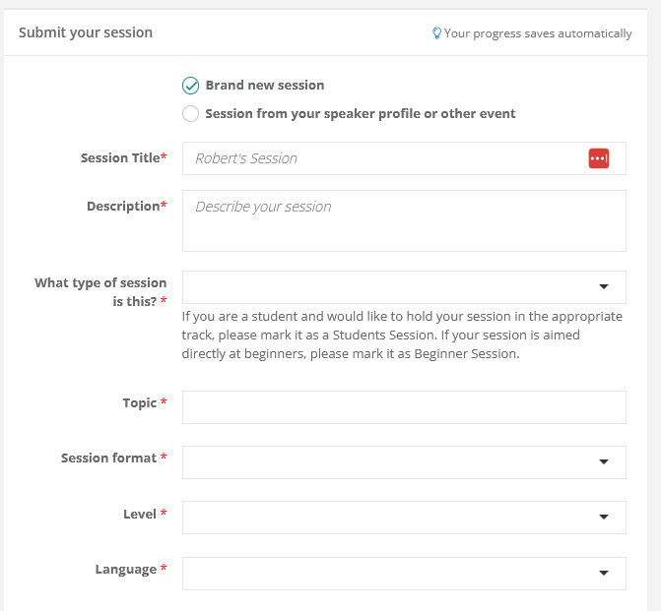

Slide 71
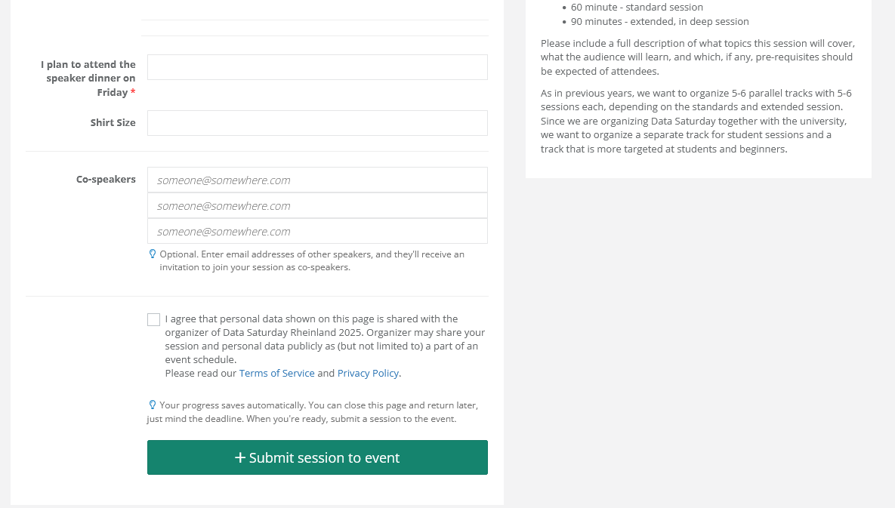

Slide 72

Notes:
Photo by Anete Lusina: https://www.pexels.com/photo/instruments-prepared-for-measurements-in-house-4792479/
Now lets exam the individual parts of the session abstract

Slide 73

Notes:
Photo by Karim Ghantous on Unsplash
The title
First thing everyone sees
Convey what you are talking about

Slide 74
Session
Description

Slide 75
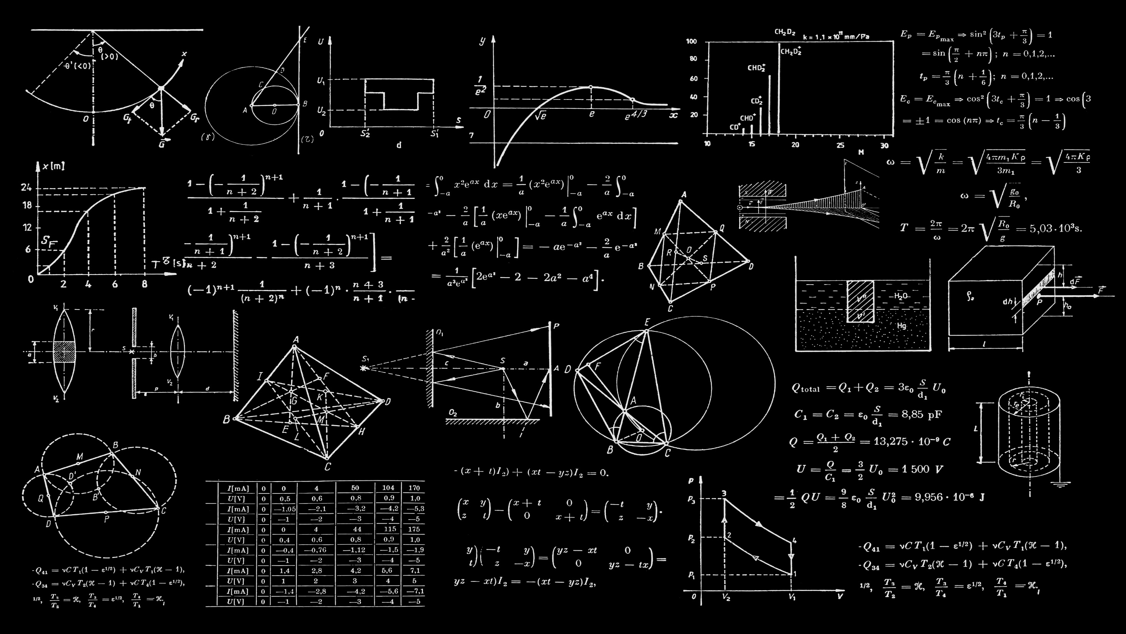
Notes:
Photo by Dan Cristian Pădureț on Unsplash
I use quite a complex formula to develop my session descriptions which I am going to share with you

Slide 76

Notes:
Photo by Magda Ehlers: https://www.pexels.com/photo/blue-red-and-yellow-stripe-surface-1329297/
It’s a
One
Two
Three
Formula

Slide 77

Notes:
Photo by Volodymyr Hryshchenko on Unsplash
Whats the problem you are trying to solve or going to solve?
What are you going to show them?

Slide 78
Challenge or problem going look at.
Notes:
Photo by Magda Ehlers: https://www.pexels.com/photo/blue-red-and-yellow-stripe-surface-1329297/

Slide 79

Notes:
Photo by Clem Onojeghuo on Unsplash
What are you going to tell them?

Slide 80
Challenge or problem going look at.
What will you tell them?
Notes:
Photo by Magda Ehlers: https://www.pexels.com/photo/blue-red-and-yellow-stripe-surface-1329297/

Slide 81

Notes:
Photo by Michael Jasmund on Unsplash
When they leave the room what are they going to leave with?

Slide 82
Challenge or problem going look at.
What will you tell them?
What will they leave with?
Notes:
Photo by Magda Ehlers: https://www.pexels.com/photo/blue-red-and-yellow-stripe-surface-1329297/

Slide 83
Notes:
Photo by Magda Ehlers: https://www.pexels.com/photo/blue-red-and-yellow-stripe-surface-1329297/
It’s a
One
Two
Three
Formula

Slide 84
Challenge or problem going look at.
What will you tell them?
What will they leave with?
Notes:
Photo by Magda Ehlers: https://www.pexels.com/photo/blue-red-and-yellow-stripe-surface-1329297/

Slide 85



Notes:
Photo by Brett Jordan on Unsplash

Slide 86

Notes:
Photo by Polina ⠀: https://www.pexels.com/photo/a-close-up-shot-of-a-handwritten-quote-6185632/
So you want to see an example

Slide 87
Title
Goldilocks and the Three Business Bears: Mastering the Art of Storytelling for Success
Challenge or Problem
Stories have a unique power to captivate, educate, and persuade. We encounter them in movies, books, and everyday conversations. Whether we realize it or not, storytelling is an exceptional tool for conveying facts, information, and ideas in a manner that lingers in the minds of our audience. The magic compels people to buy into your concepts, rally behind your projects, and take meaningful actions.
The fantastic news is that storytelling is a skill that can be learned and developed. Scientists have delved into the art of storytelling, and industry icons like Steve Jobs have showcased its transformative potential.

Slide 88
Going to tell them what?
In this captivating session, we will embark on a journey through the world of storytelling. We will explore the architecture of stories and how they forge connections with people on a deep level. Even more exciting, we will delve into the techniques and strategies employed by master storytellers and learn how to wield them in our professional endeavours. Discover how to create narratives that not only engage but also persuade. Gain insights into the secrets of captivating your audience, just as Steve Jobs did with his iconic presentations. By the end of this session, you will possess the knowledge and tools to leverage storytelling to showcase why your business case is superior and inspire others to champion your ideas.
Leave with?
Join us in the enchanting realm of storytelling, where the power of persuasion and communication awaits your grasp. Whether you're a natural storyteller or new to the art, this session promises to unlock the secrets behind crafting compelling narratives for business success.

Slide 89
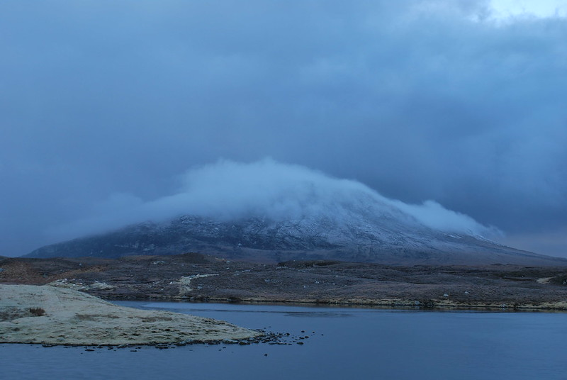

Slide 90
Title
Power BI and Azure DevOps a match made in heaven
Challenge or Problem
Do you want to incorporate Dev Ops into your Power BI work? Have you started using Power BI Project files? Have you been amazed at what the new TSML file format can do? There is so much potential in checking the files into source control and allowing more than one person to simultaneously work on the same semantic model or report. The possibilities are just fantastic. But where do you start? How do you make it work with Azure Dev Ops? Does it work with Visual Code? What about the Power BI service? So many questions!

Slide 91
Going to tell them what?
In this session, we will help you get Power BI and Azure Dev Ops working together. We will explain the different options and how to set up Azure Dev Ops in simple language. Give step-by-step instructions for integrating your project files into Azure Dev Ops and the Power BI service. We will step you through the process of how we do it. In this joint session, the Chief Power BI nerd and Dev Ops Guru will explain how easy it is to get Power BI and Azure Dev Ops to work together.
Leave with?
Leaving this session, you will have an excellent overview of integrating your Power BI projects and service with Azure Dev Ops and an understanding of the various terms, acronyms, and other buzzwords. Know your push from your pull and what a branch and fork do for you. When you return to The office, do you need to take steps to get a Dev Ops pipeline up and running?

Slide 92
Challenge or problem going look at.
What will you tell them?
What will they leave with?
Notes:
Photo by Magda Ehlers: https://www.pexels.com/photo/blue-red-and-yellow-stripe-surface-1329297/

Slide 93

Notes:
Photo by Nick Fewings on Unsplash
Yes you are probably going to get rejections and its going to hurt

Slide 94


Slide 95
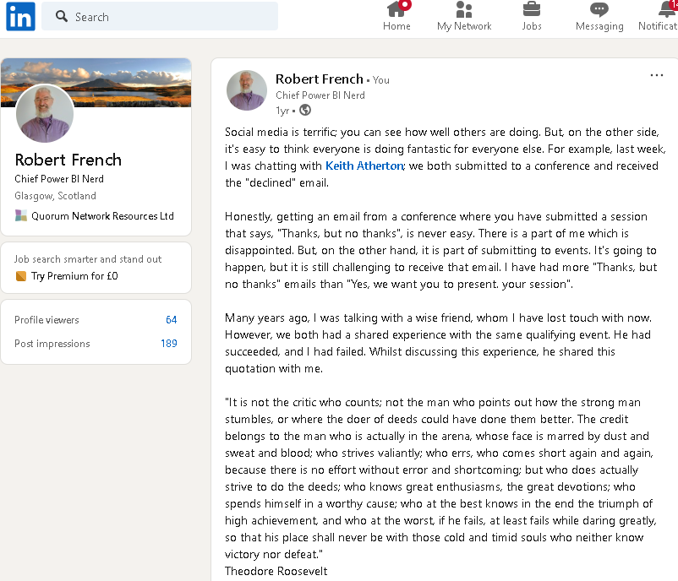
Notes:
https://www.linkedin.com/posts/rwlpfrench_social-media-is-terrific-you-can-see-how-activity-7066321792310620160-rJv7/?utm_source=share&utm_medium=member_desktop

Slide 96
Notes:
Photo by DS stories: https://www.pexels.com/photo/bronze-medal-on-white-7267601/

Slide 97
Personas

Slide 98

Notes:
Photo by Hennie Stander on Unsplash
Lets start with a question

Slide 99

Notes:
Photo by Wan San Yip on Unsplash
Who is your audience
How well do you know your audience?

Slide 100

Notes:
What about sorting our audience into different categories?
Photo by Luis Quintero from Pexels

Slide 101

Notes:
Photo by RealToughCandy.com: https://www.pexels.com/photo/a-person-holding-red-and-white-card-11035388/

Slide 102

Data
Base
Admin
Notes:
Photo by Christian Buehner on Unsplash

Slide 103

https://ourstoryinthemaking.com/stories/the-one-with-the-f1-team
Notes:
Bernadette (Bernie) Collins
Was Strategy Engineer for Aston Martin F1 team

Slide 104

Notes:
Who is uncomfortable with numbers
Photo by Nik Shuliahin on Unsplash

Slide 105

Notes:
Who is the audience - What are their data literacy levels
Are they a maths graduate
Background in Local government finance
F1 racing mechanic
Meet the inspirational women proving that F1 is ‘more than a man’s world’ (marieclaire.co.uk)
12 Top Car Racing Drivers That Happen to Be Women: 24 Hours of Daytona - Bloomberg
Artist with dyslexia
Photo by RF._.studio from Pexels

Slide 106

Personas
Notes:
https://dribbble.com/shots/1938508-Free-User-pics

Slide 107
“…nobody uses them…
why should we use them?”
Notes:
This might be something some people are thinking? You told about personas

Slide 108

Notes:
Some people think it’s a good idea, some do not lets look at which organisations use personas
https://www.pexels.com/photo/banking-business-checklist-commerce-416322/

Slide 109


Slide 110
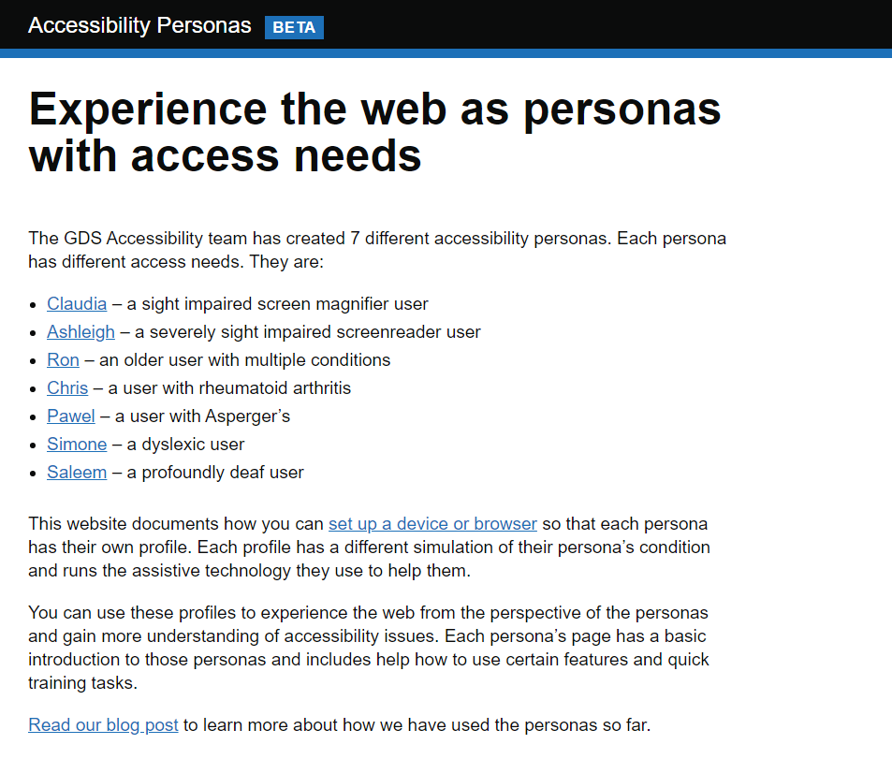
Notes:
https://alphagov.github.io/accessibility-personas/

Slide 111

Define your audience?
Notes:
Many humans like to sort things into different categories
Photo by cottonbro from Pexels

Slide 112



Notes:
Photo by Piotrek on Unsplash
Photo by Piotrek on Unsplash
Photo by sean hall on Unsplash

Slide 113
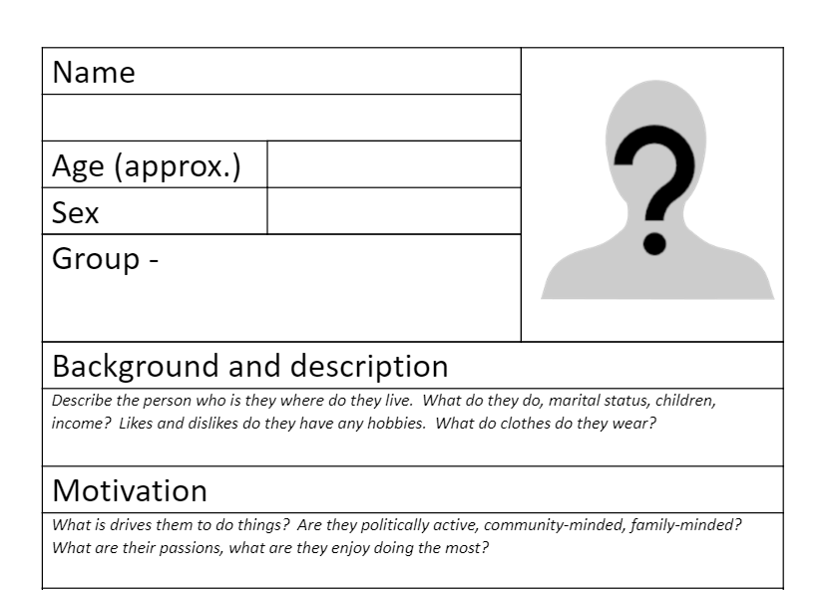
Notes:
This is an example form I use for defining personas, as a starting point

Slide 114


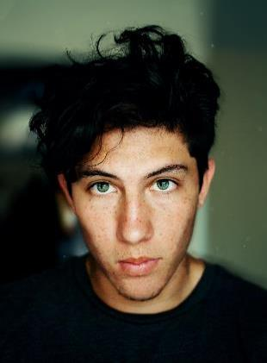
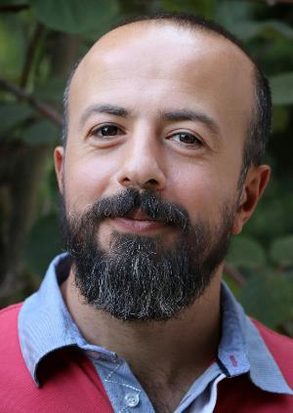
https://unsplash.com/s/photos/face
Notes:
Use photographs of really people
Photo by Reza Biazar on Unsplash
Photo by Prince Akachi on Unsplash
Photo by Imansyah Muhamad Putera on Unsplash

Slide 115




https://www.pexels.com/search/face/
Notes:
Photo by Italo Melo from Pexels
Photo by Marcus Aurelius: https://www.pexels.com/photo/woman-smiling-at-the-camera-6787567/

Slide 116

Notes:
Yes I do eat my own dog food
Photo by Kabo on Unsplash

Slide 117
"Eat your own dog food"
“Show people that you do, what you tell other people to do……"

Slide 118

Don’t just talk the talk
Walk the Walk

Slide 119

Notes:
As in all the good cookery shows here’s is one I prepared earlier
Photo by Phinehas Adams on Unsplash

Slide 120


Slide 121
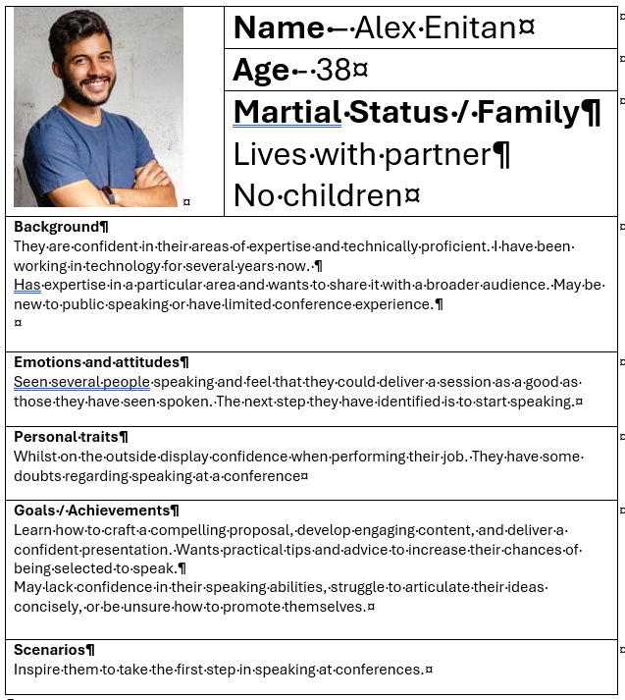

Slide 122
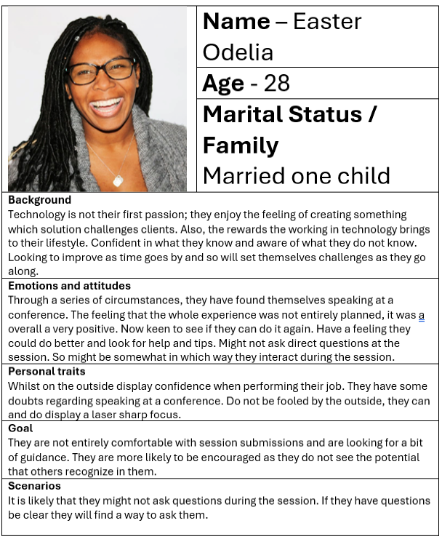

Slide 123
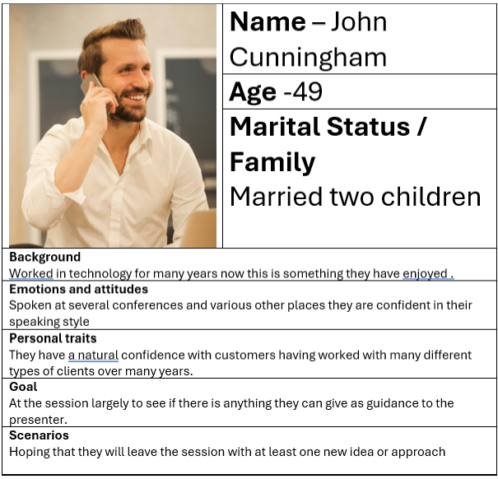

Slide 124

Notes:
Photo by <a href="https://unsplash.com/@naassomz1?utm_content=creditCopyText&utm_medium=referral&utm_source=unsplash">Naassom Azevedo</a> on <a href="https://unsplash.com/photos/group-of-people-sitting-on-bench-near-trees-duting-daytime-Q_Sei-TqSlc?utm_content=creditCopyText&utm_medium=referral&utm_source=unsplash">Unsplash</a>
We are psychological wired to consider people not abstract names for groups of people

Slide 125

Notes:
Now what do I do with them?
Photo by <a href="https://unsplash.com/@timmossholder?utm_content=creditCopyText&utm_medium=referral&utm_source=unsplash">Tim Mossholder</a> on <a href="https://unsplash.com/photos/text-DZcZ4Kskq6U?utm_content=creditCopyText&utm_medium=referral&utm_source=unsplash">Unsplash</a>

Slide 126

Notes:
Photo by <a href="https://unsplash.com/@dtravisphd?utm_content=creditCopyText&utm_medium=referral&utm_source=unsplash">David Travis</a> on <a href="https://unsplash.com/photos/person-holding-eyeglasses-aVvZJC0ynBQ?utm_content=creditCopyText&utm_medium=referral&utm_source=unsplash">Unsplash</a>
How does the world look when you look through some else's eyes or glasses ?

Slide 127
What should be included?

Slide 128

Notes:
Photo by <a href="https://unsplash.com/@jcmarin?utm_content=creditCopyText&utm_medium=referral&utm_source=unsplash">Juan Marin</a> on <a href="https://unsplash.com/photos/ideas-carved-on-concrete-surface-CjDuFaoVQD8?utm_content=creditCopyText&utm_medium=referral&utm_source=unsplash">Unsplash</a>
Here is some ideas

Slide 129

Notes:
Photo by Anna Tarazevich: https://www.pexels.com/photo/goal-lettering-text-on-black-background-5598296/
What is their goal, what are they trying to get from the data visualation

Slide 130

Notes:
Photo by Andrea Piacquadio: https://www.pexels.com/photo/photo-of-man-touching-his-head-3752834/
What are their pain points?
Are they a busy parent or teacher or saleperson with lots of distractions

Slide 131

Notes:
Photo by Cliff Booth: https://www.pexels.com/photo/young-girl-using-a-laptop-while-having-breakfast-4058218/
What are people's abilities

Slide 132
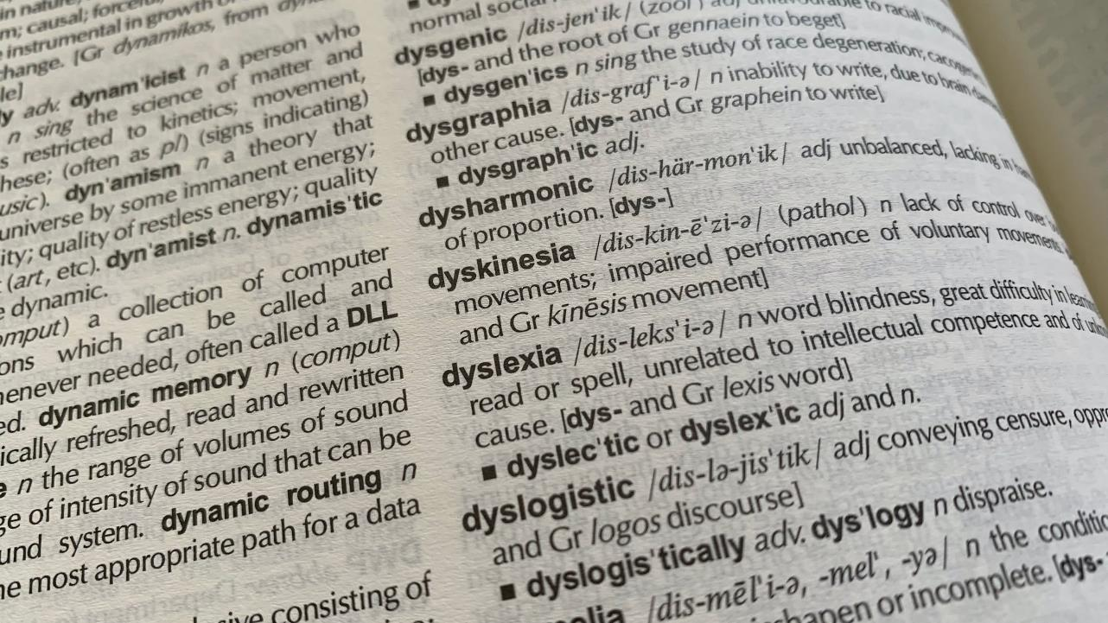
Notes:
Photo by <a href="https://unsplash.com/@rob_hobson?utm_content=creditCopyText&utm_medium=referral&utm_source=unsplash">Rob Hobson</a> on <a href="https://unsplash.com/photos/a-close-up-of-a-book-with-words-on-it-0apZjDdRS5o?utm_content=creditCopyText&utm_medium=referral&utm_source=unsplash">Unsplash</a>
Are they dyslexic?

Slide 133

Notes:
Photo by <a href="https://unsplash.com/@mango_quan?utm_content=creditCopyText&utm_medium=referral&utm_source=unsplash">Harry Quan</a> on <a href="https://unsplash.com/photos/close-up-photography-of-rainbow-rays-on-eye-G1iYCeCW2EI?utm_content=creditCopyText&utm_medium=referral&utm_source=unsplash">Unsplash</a>
Are they colour blind?

Slide 134

Notes:
Photo by <a href="https://unsplash.com/@nickpage?utm_content=creditCopyText&utm_medium=referral&utm_source=unsplash">Nick Page</a> on <a href="https://unsplash.com/photos/a-close-up-of-a-sign-on-a-building-xJePstYD8Pg?utm_content=creditCopyText&utm_medium=referral&utm_source=unsplash">Unsplash</a>
How are they feeling when looking at your data visualization?

Slide 135

Notes:
Photo by <a href="https://unsplash.com/@brett_jordan?utm_content=creditCopyText&utm_medium=referral&utm_source=unsplash">Brett Jordan</a> on <a href="https://unsplash.com/photos/brown-wooden-blocks-on-white-surface-hjI67-48t5I?utm_content=creditCopyText&utm_medium=referral&utm_source=unsplash">Unsplash</a>
What might they want to achieve with the data viz
Save money
Detect poor performance
Check have enough money in the bank

Slide 136
Notes:
Photo by Christian Buehner on Unsplash

Slide 137
Notes:
Photo by Natasha Connell on Unsplash
Going to talk about memory specifically short and long term memory

Slide 138

Notes:
Its not easy to learn a new skill
Photo by The Ride Academy on Unsplash

Slide 139

Notes:
How to do we learn? – sometimes we feel there is so much to learn !
Photo by Tim Gouw on Unsplash

Slide 140
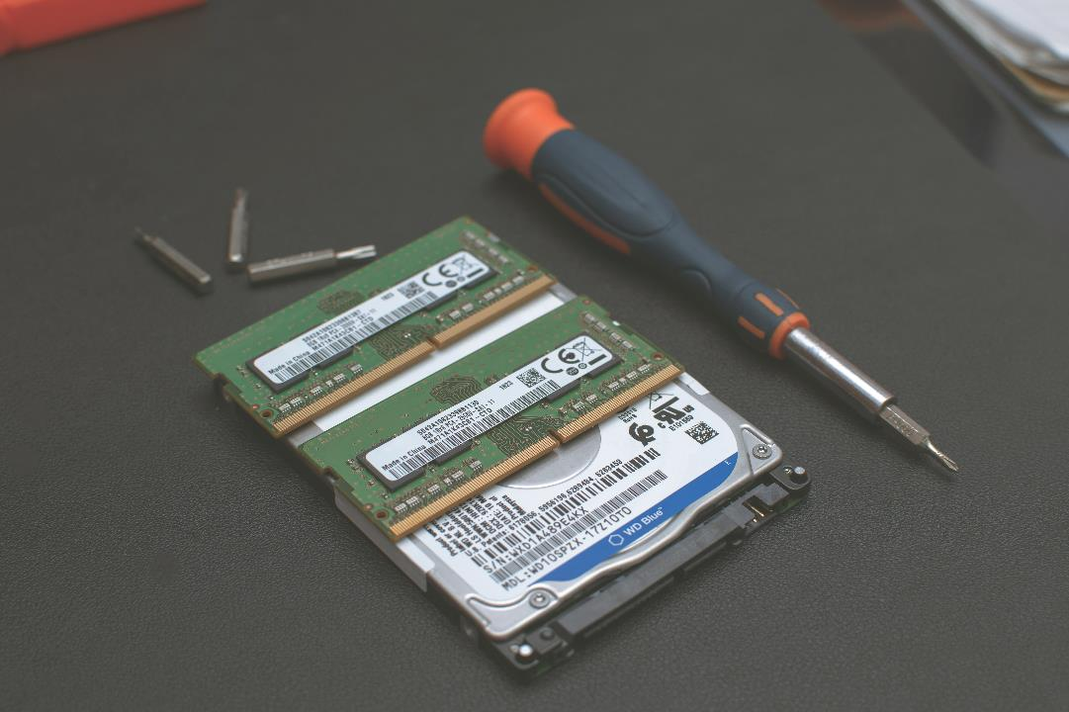
Notes:
Two types of memory
Photo by Heliberto Arias on Unsplash

Slide 141
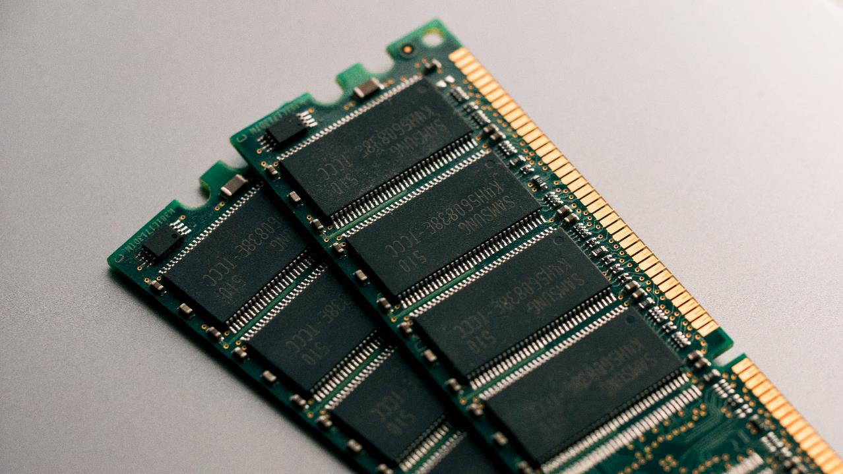
Notes:
Working memory - which is store term more of scratch pad more than anything
Photo by Harrison Broadbent on Unsplash

Slide 142

Notes:
Long term memory – which is where we store
Photo by Azamat Esenaliev from Pexels

Slide 143

Notes:
For the example we are going to assume three slots
Photo by Tony Hand on Unsplash

Slide 144
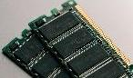

“Computer Ram”
Slot one
Slot two
Slot three
“Hard Drive”

Slide 145



“Working memory”
Slot one
Slot two
Slot three
“Long Term memory”

Slide 146
“Working memory”
Slot one
Slot two
Slot three
“Long Term memory”

Slide 147

“Working memory”
Slot one
Slot two
Slot three
“Long Term memory”

Slide 148

“Working memory”
Slot one
Slot two
Slot three
“Long Term memory”

Slide 149
“Working memory”
Slot one
Slot two
Slot three
“Long Term memory”

Slide 150


Slide 151

Notes:
https://www.smashingmagazine.com/2016/09/reducing-cognitive-overload-for-a-better-user-experience/

Slide 152
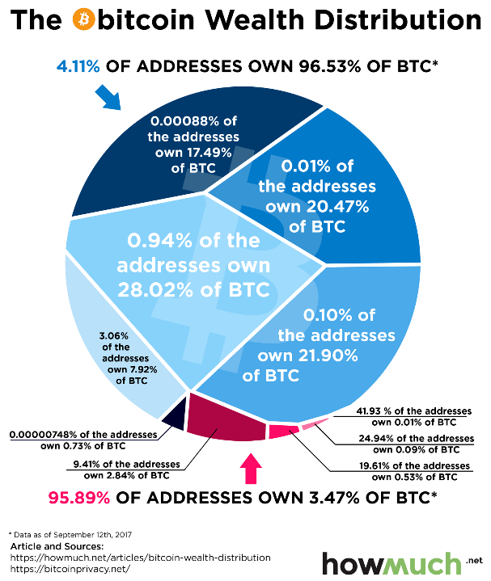

Slide 153
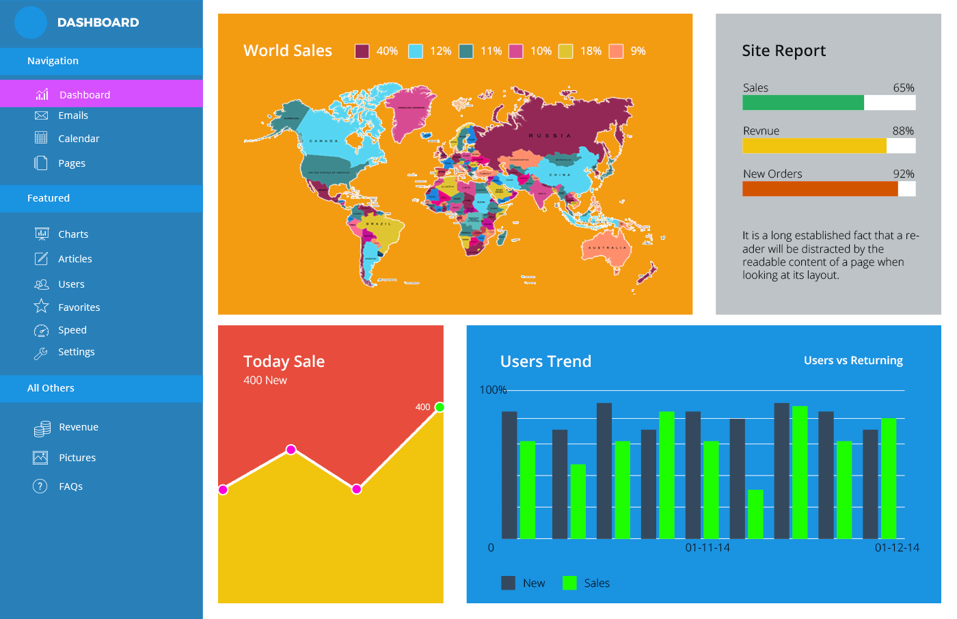
10 Dashboard Design Errors And How To Avoid Them (fusioncharts.com)10 Dashboard Design Errors And How To Avoid Them (fusioncharts.com)

Slide 154


Slide 155

There are only THREE slots in my working memory
Notes:
Photo by Atul Choudhary from Pexels

Slide 156
Notes:
Photo by Miguel Á. Padriñán: https://www.pexels.com/photo/gold-5-illustration-2249532/

Slide 157


Slide 158

The Curse
Notes:
Photo by Gabriella Clare Marino on Unsplash

Slide 159

The
Drumming game
Notes:
Inspired by - Made to Stick by Chip Heath & Dan Heath
https://dr-biz.com/story-on-communication-tappers-and-listeners/
Elizbeth Newton 1990
"Overconfidence in the communication of intent: Heard and Unheard Melodies: Phd Diss Standford University 1990
https://en.wikipedia.org/wiki/Curse_of_knowledge
Photo by Allef Vinicius on Unsplash

Slide 160
Two groups
Tappers
Listeners

Slide 161
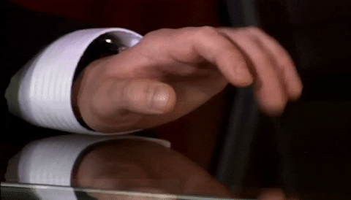
Tappers
Notes:
Each tapper was given 25 well known songs to tap out eg
Happy Birthday,
Merry Christmas,
Star Spangled Banner

Slide 162
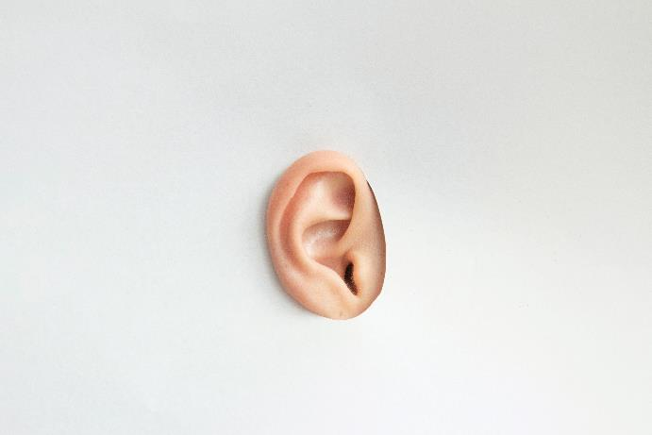
Listeners
Notes:
A listener was paired with each tapper, to listen to the tapper tap out the tune. Simple as that.

Slide 163

Quiz time
Notes:
Photo by Museums Victoria on Unsplash

Slide 164

>75% of the time
Notes:
How often did the listeners guess the tune?

Slide 165
>50% of the time
Notes:
How often did the listeners guess the tune?

Slide 166

>25% of the time
Notes:
How often did the listeners guess the tune?
Photo by Dean Ward on Unsplash

Slide 167
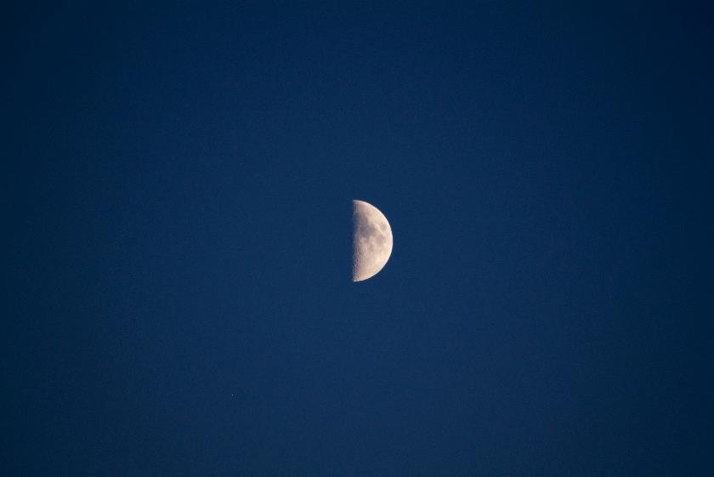
Tappers predicated listeners would guess the tune
50%
of the time.
Notes:
Photo by Edge2Edge Media on Unsplash

Slide 168

Repeated
120
times
Notes:
Photo by Mitchell Luo on Unsplash

Slide 169
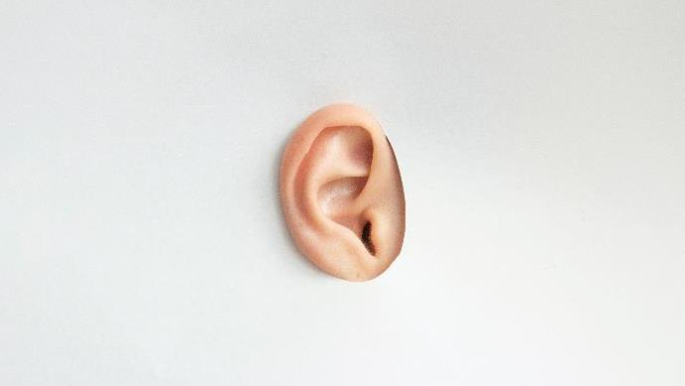
Listeners correctly guessed the tune
Notes:
How often did the listeners correctly guess the tune?

Slide 170

Notes:
Photo by Tony Hand on Unsplash
times out of 120 attempts
Success rate of 2.5 %

Slide 171
Curse
of
knowledge
Notes:
https://www.journals.uchicago.edu/doi/abs/10.1086/261651
The Curse of Knowledge in Economic Settings: An Experimental Analysis
Photo by Cederic Vandenberghe on Unsplash

Slide 172


We all know?
Notes:
Photo by Kelly Sikkema on Unsplash

Slide 173

“….that‘s what I do read books and know things….”
Notes:
Photo by Susan Q Yin on Unsplash
We are all information workers, we read books, blog posts, listen to podcasts

Slide 174

Notes:
Photo by Markus Spiske on Unsplash
Not everyone knows what you know

Slide 175
Tapper
Notes:
I feel very much like a tapper

Slide 176
Listener
Notes:
I need to learn to see and understand as a listener does

Slide 177
Notes:
Photo by Clem Onojeghuo on Unsplash

Slide 178
If you fail to plan,
you are planning to fail

Slide 179
Notes:
Photo by Nick Seagrave on Unsplash
Create a mind map to get all the ideas out on somewhere

Slide 180
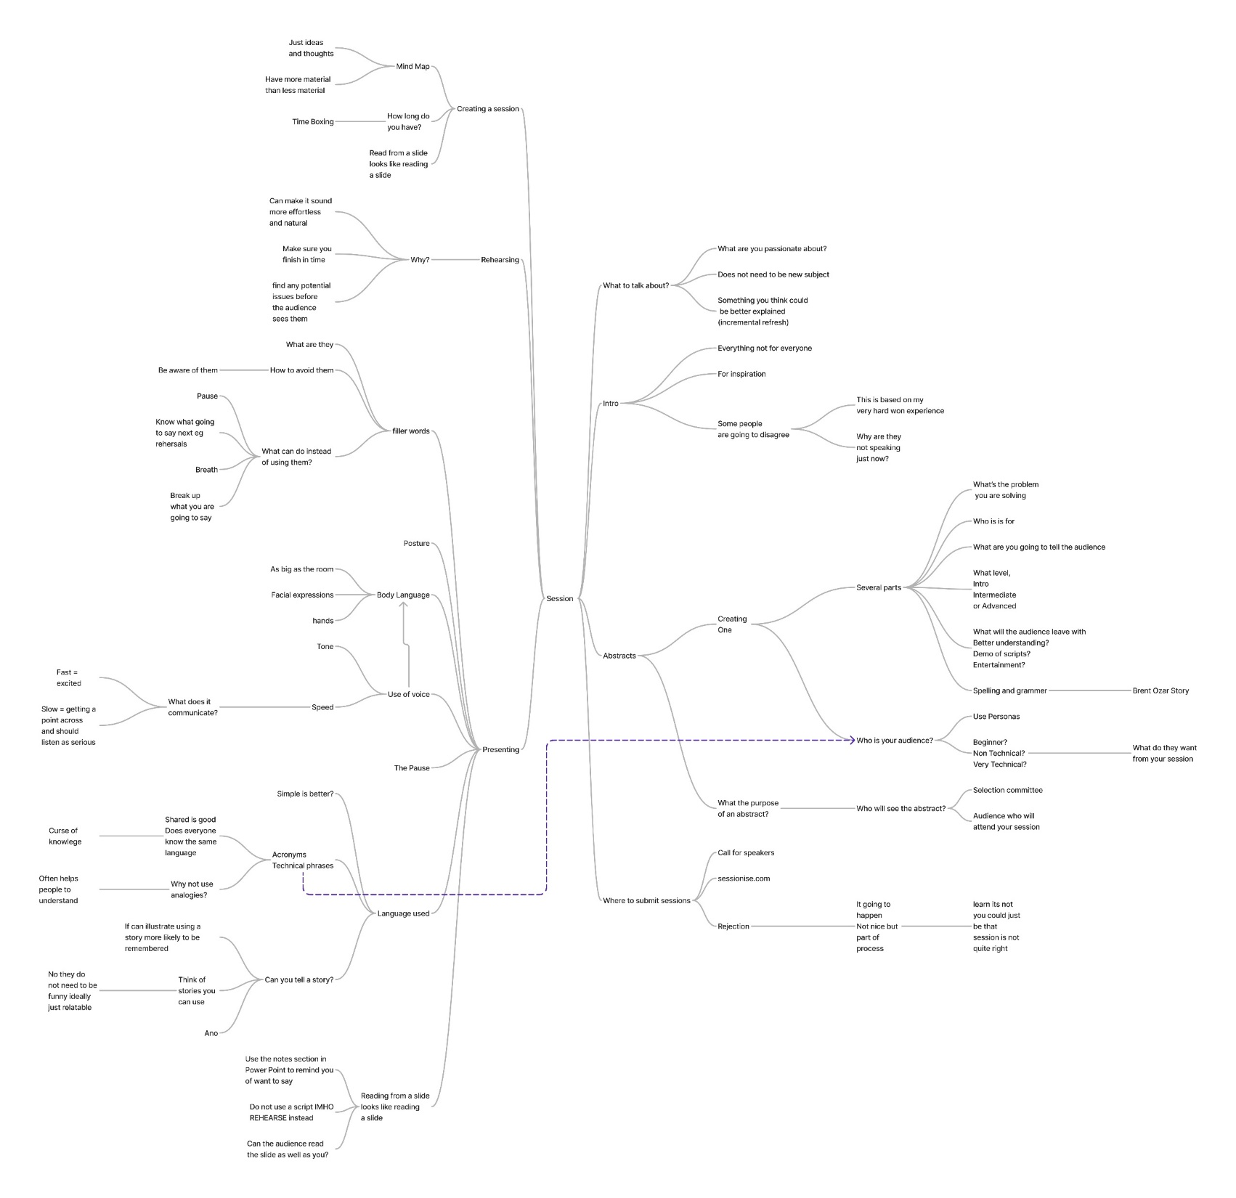

Slide 181
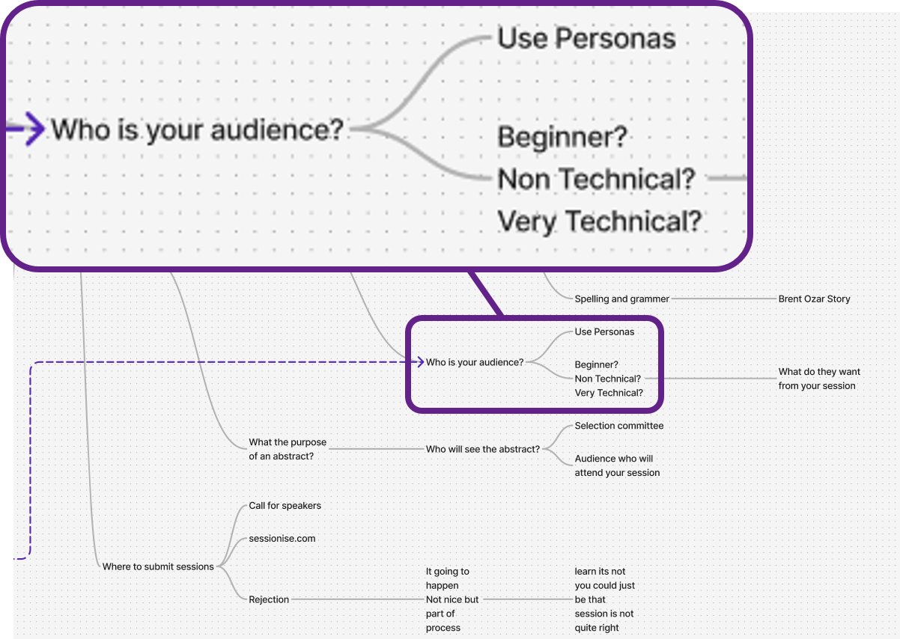

Slide 182

Notes:
Photo by Lukas Blazek on Unsplash

Slide 183
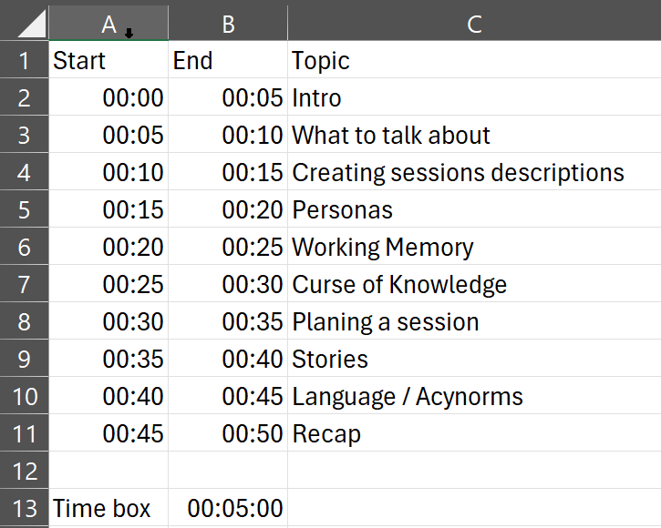

Slide 184
Three parts to the session
1) Tell them what you are going to tell them

Slide 185
Three parts to the session
2) Tell them what you are going to tell them.

Slide 186
Three parts to the session
3) Tell them what told them.

Slide 187
Three parts to the session
Four
4) Give them a call to action.

Slide 188
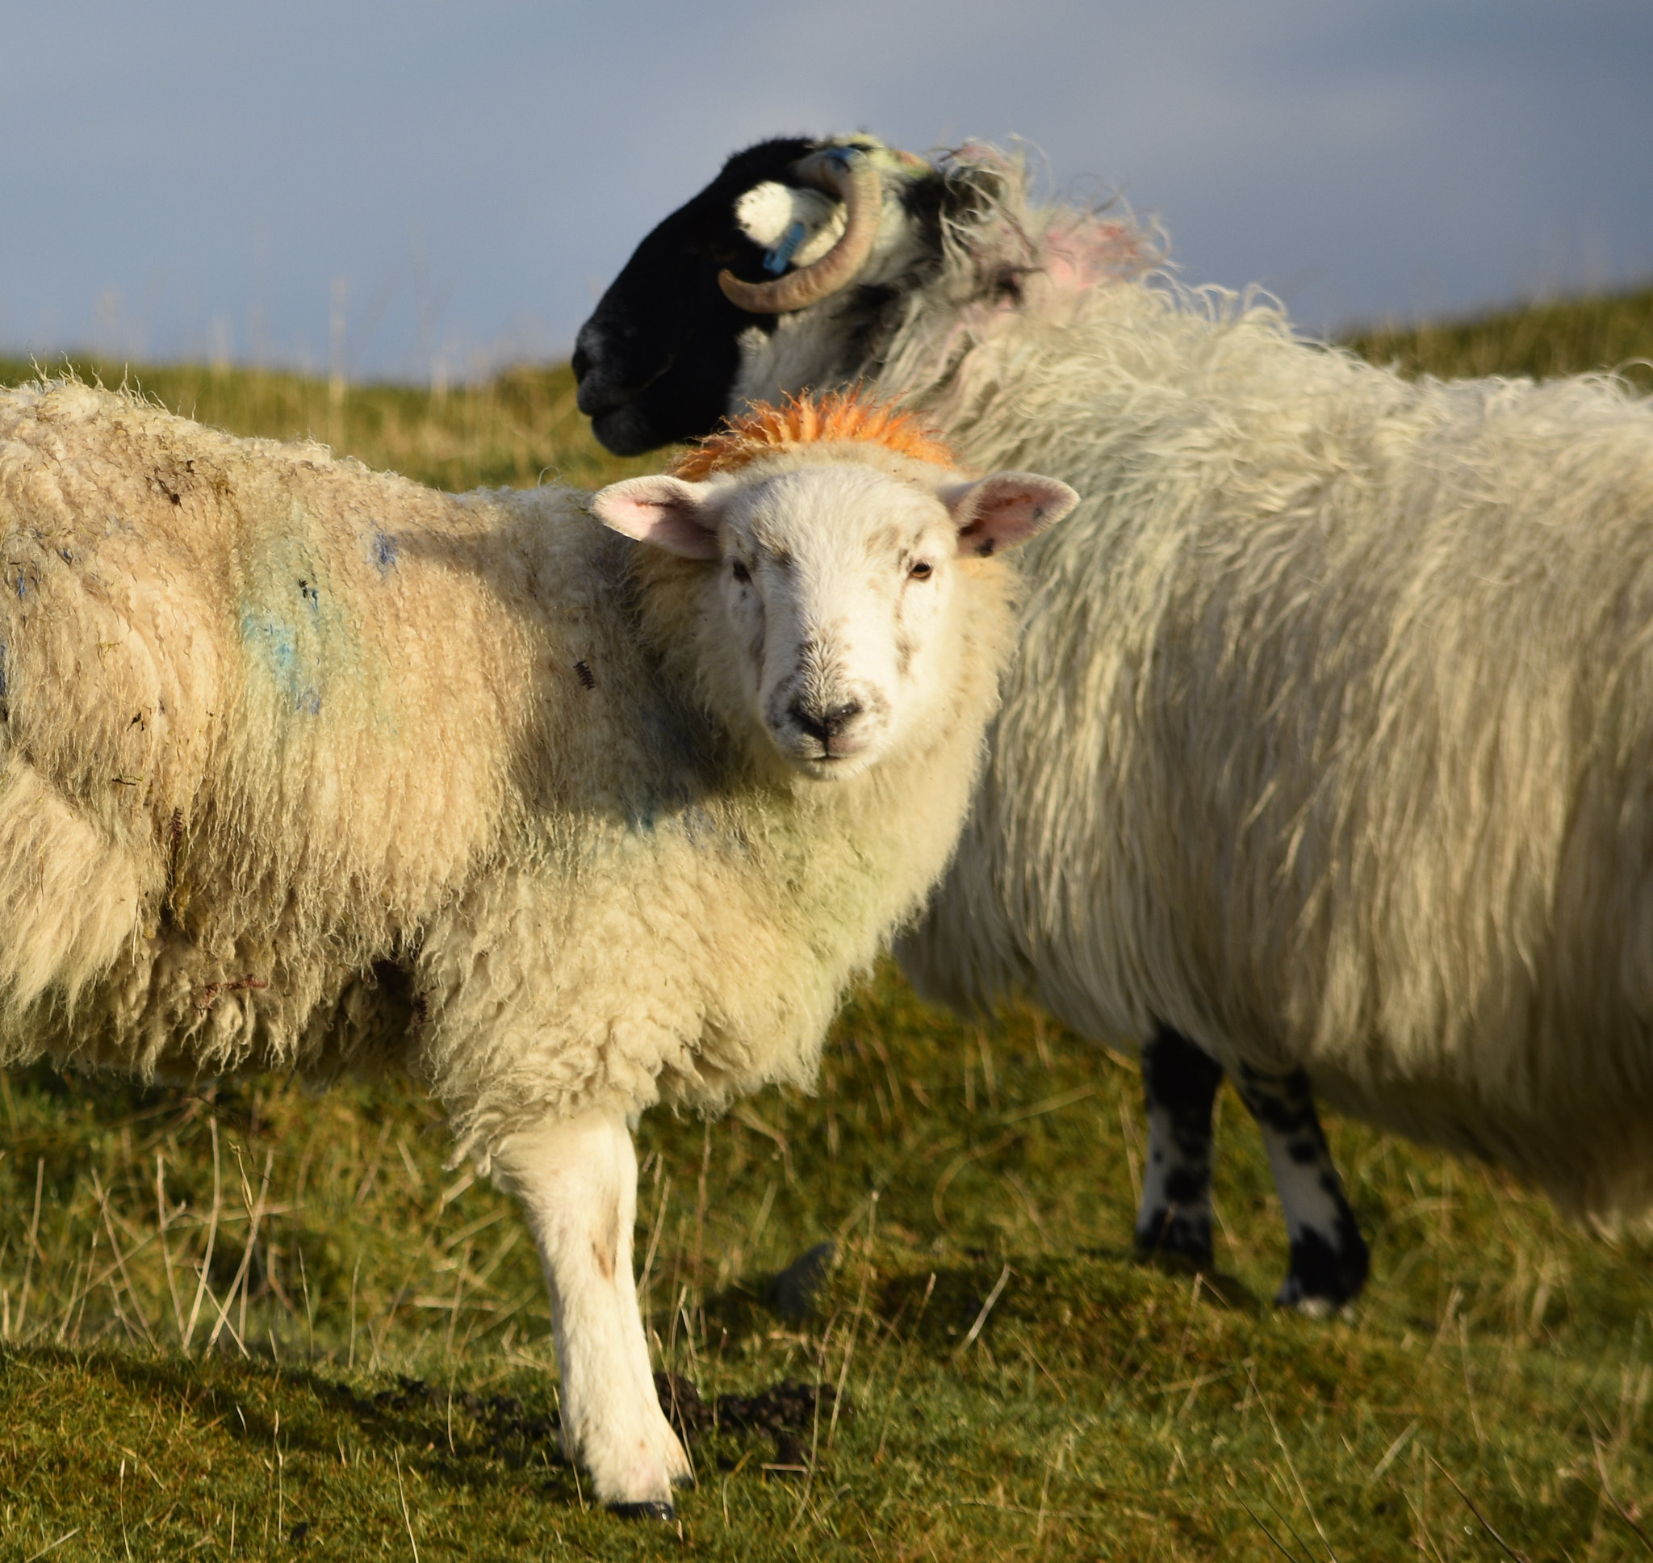

Slide 189
Notes:
Photo by Eric Prouzet on Unsplash

Slide 190
Notes:
Photo by Nick Fewings on Unsplash
Some ideas for presentations

Slide 191

Notes:
Photo by Brett Jordan on Unsplash

Slide 192

Notes:
Photo by Mikael Seegen on Unsplash
This next section is a little controversial

Slide 193
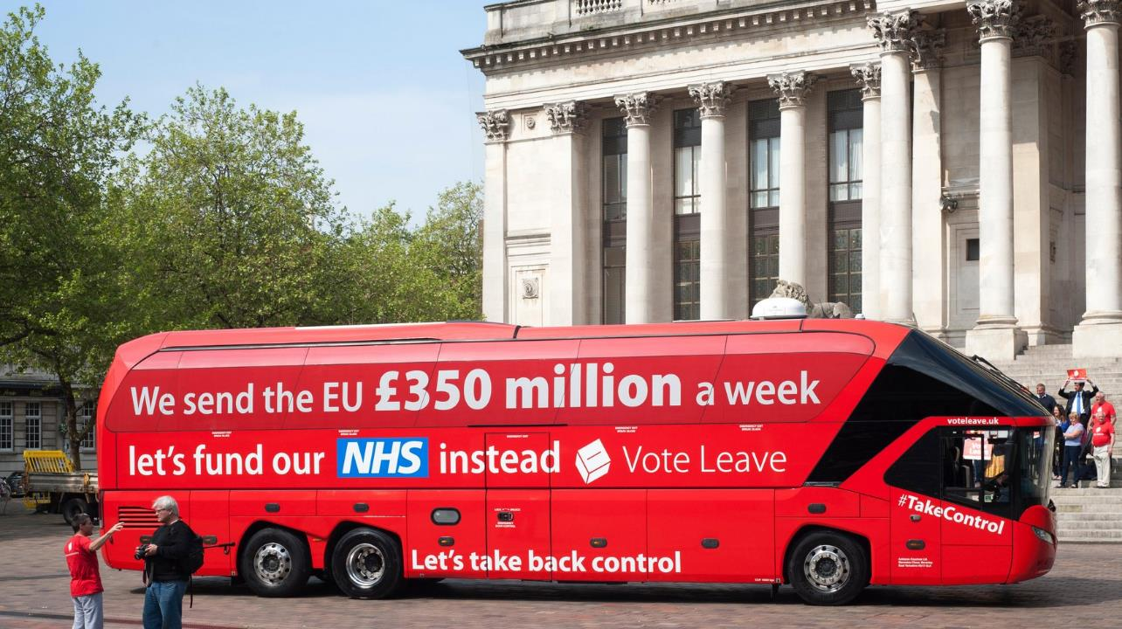
Notes:
Ordered by:- rwlp.french@gmail.com
Order reference- OY67246107

Slide 194
Story
Notes:
Ordered by:- rwlp.french@gmail.com
Order reference- OY67246107

Slide 195
Story
Data
Notes:
Ordered by:- rwlp.french@gmail.com
Order reference- OY67246107

Slide 196
Story
Data
Narrative
Notes:
Ordered by:- rwlp.french@gmail.com
Order reference- OY67246107

Slide 197
Story
Data
Narrative
Call to action
Notes:
Ordered by:- rwlp.french@gmail.com
Order reference- OY67246107

Slide 198

Notes:
There is more

Slide 199
“…Two-thirds of leave supporters still believe the discredited claim that the UK sends £350 million per week to the EU, compared with only one in five remain supporters……"
(from "The Perils of Perception: Why We’re Wrong About Nearly Everything" by Bobby Duffy)
Notes:
Discredited
Debunked
Refuted
Rejected
Discarded
Shamed
Disgraced

Slide 200
Stories

Slide 201


Slide 202

Notes:
Photo by Brett Jordan on Unsplash

Slide 203

I.T.
Acronym’s

Slide 204
Acronym’s
acronym is a word or name formed as an abbreviation
Examples
UN
United Nations
BBC
British Broadcasting Corporation

Slide 205

Guess the acronym

Slide 206
HTML
Hyper Text Mark up Language
ETA
Estimated Time of Arrival

Slide 207
ADF
American Defence Festival
https://encyclopedia.thefreedictionary.com/American+Dance+Festival
African Development Fund
https://encyclopedia.thefreedictionary.com/African+Development+Foundation
ETL
Environmental Technology Laboratory
https://encyclopedia.thefreedictionary.com/Environmental+Technology+Laboratory

Slide 208

Notes:
I SUGGEST that you think about those people you are speaking to

Slide 209
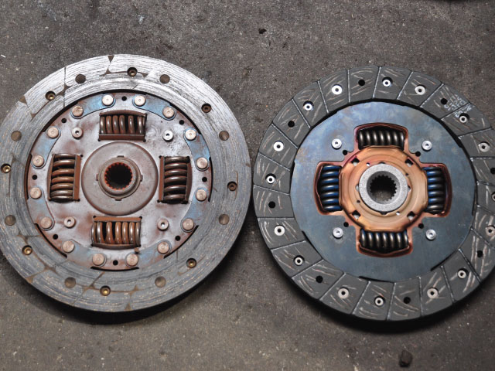
Notes:
Story about clutch illustrates the curse of knowledge

Slide 210
Language

Slide 211
Curse of
knowledge

Slide 212
“Computer Ram”
Slot one
Slot two
Slot three
“Hard Drive”

Slide 213
“Working memory”
Slot one
Slot two
Slot three
“Long Term memory”

Slide 214
Analogies

Slide 215
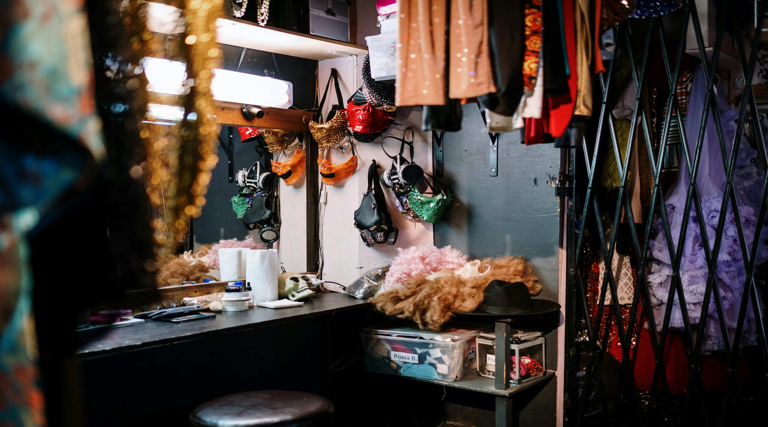
Notes:
Photo by cottonbro studio: https://www.pexels.com/photo/assorted-items-on-black-table-4716541/

Slide 216
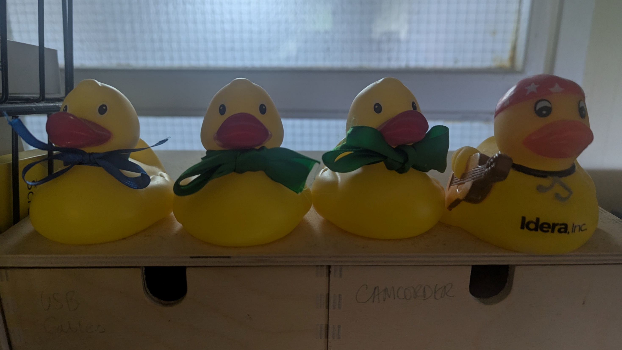
Notes:
Introducing the data duckies used during the session on incremental refresh in Power BI

Slide 217
Props

Slide 218

https://bit.ly/3ECsJYH?r=qr

Slide 219
Notes:
Photo by Marcel Eberle on Unsplash
Find at topic

Slide 220
Notes:
Photo by Emily Morter on Unsplash
So what should you take about?
For some this is an easy answer
Some not so easy
So here is some ideas

Slide 221
Notes:
Photo by Waldemar on Unsplash

Slide 222
Notes:
Photo by Kelly Sikkema on Unsplash
Creating abstract

Slide 223
Notes:
Photo by DS stories: https://www.pexels.com/photo/bronze-medal-on-white-7267601/

Slide 224
Notes:
You have been asked to create a dashboard

Slide 225
Notes:
Photo by Christian Buehner on Unsplash

Slide 226
Notes:
Photo by Natasha Connell on Unsplash
Going to talk about memory specifically short and long term memory

Slide 227
Notes:
Photo by Miguel Á. Padriñán: https://www.pexels.com/photo/gold-5-illustration-2249532/

Slide 228
Curse
of
knowledge
Notes:
https://www.journals.uchicago.edu/doi/abs/10.1086/261651
The Curse of Knowledge in Economic Settings: An Experimental Analysis
Photo by Cederic Vandenberghe on Unsplash

Slide 229
Notes:
Photo by Clem Onojeghuo on Unsplash

Slide 230

Notes:
Photo by Nick Seagrave on Unsplash
Create a mind map to get all the ideas out on somewhere

Slide 231
Notes:
Photo by Eric Prouzet on Unsplash

Slide 232
Notes:
Photo by Nick Fewings on Unsplash
Some ideas for presentations

Slide 233

Notes:
Photo by sydney Rae on Unsplash

Slide 234
Robert French
Chief Power BI Nerd at Quorum
Lives in Sunny Glasgow, Scotland
rwlp.french@gmail.com
@sqlbobscot
https://www.linkedin.com/in/rwlpfrench/
https://www.qnrl.com/

Slide 235
https://bit.ly/3ECsJYH?r=qr

